Slide 1


Topic Modeling and Sentiment Analysis of User Reviews
Latent Dirichlet Allocation (LDA) Model
Project Members
Sajal Debnath
Krishanu Chattopadhyay
November 22, 2024

Slide 2
Project Description
Topic Modeling and Sentiment Analysis of User Reviews
It is very important for any organization in today’s world to know the feedback and customer sentiments about their business generally in the form of reviews. This is more true for service industries like hotels, restaurants to name a few. But with the numbers being in thousands and lakhs, it is humanely impossible to read all the feedbacks and understand/co-relate the sentiments.
We are trying to solve this problem through machine learning models. Where we want to create a model which not only can go through all the reviews but divide them into topics and then find out the general sentiments on them.
So, we are aiming to do topic modeling which is used to discover hidden themes and patterns within large collections of text data, allowing researchers and analysts to understand the underlying topics discussed in a corpus of documents without manually reading each one, essentially providing a way to organize and make sense of large volumes of unstructured information by identifying recurring themes and keywords across the data.

Slide 3
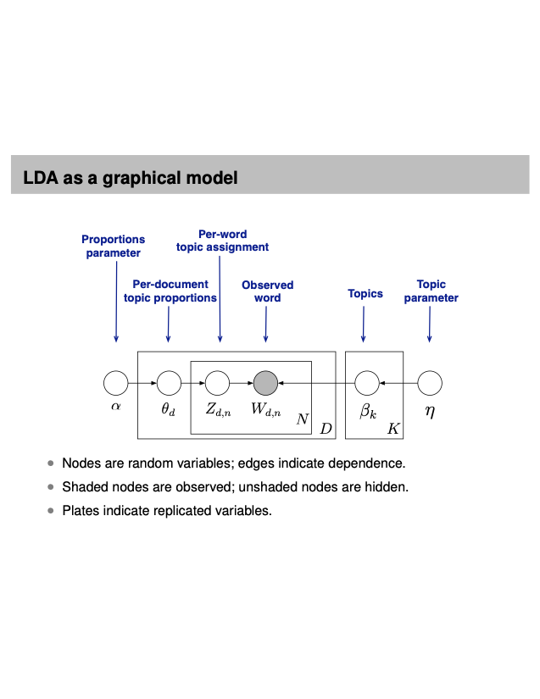
LDA Graphical Model
Topic Modeling using LDA
LDA performs text analysis with probability models.
LDA discovers themes using posterior inference.
LDA helps us discover hidden themes in documents.
How does LDA Work?
LDA trades off 2 goals
In each document, allocate its words to few topics
In each topic, assign high probability to few terms.
These 2 goals are at odds
Trading off these goals finds groups of tightly co-occurring words.

Slide 4

Trip Advisor Dataset, Data cleanup and Data preprocessing methods
Dataset
Review data downloaded from
– Trip Advisor Hotel Reviews
Data cleanup
Used regular expression to remove
– Links, Mention symbol, Hashtag, Punctuations
Data preprocessing
– Lower casing
– Stop word filtering
– Lemmatization

Slide 5
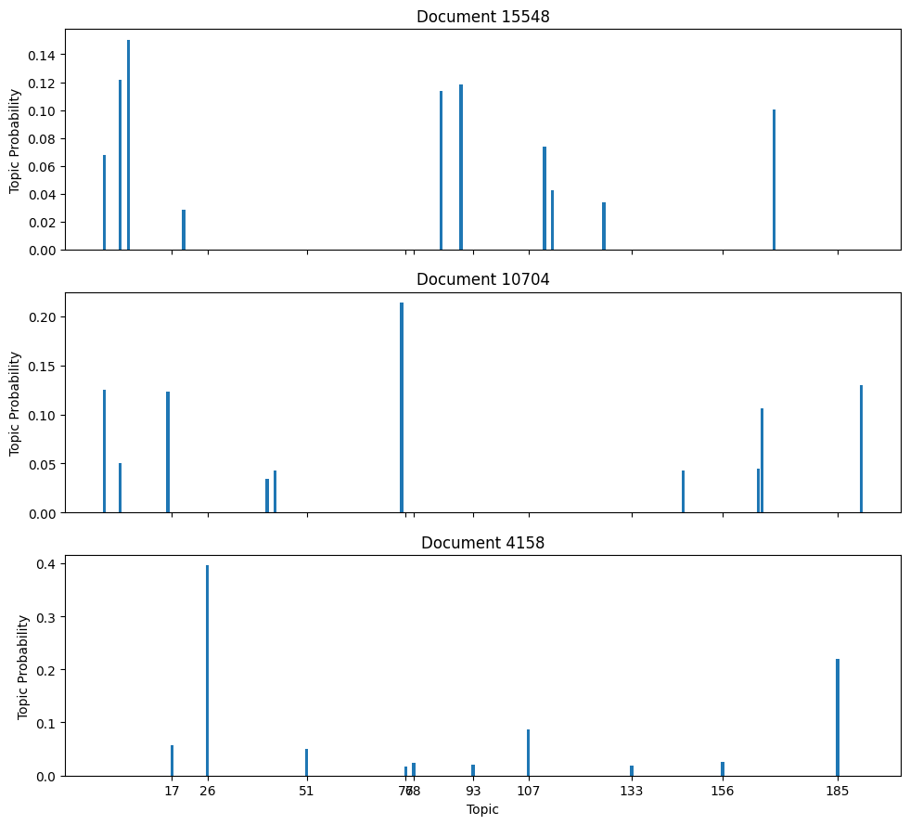
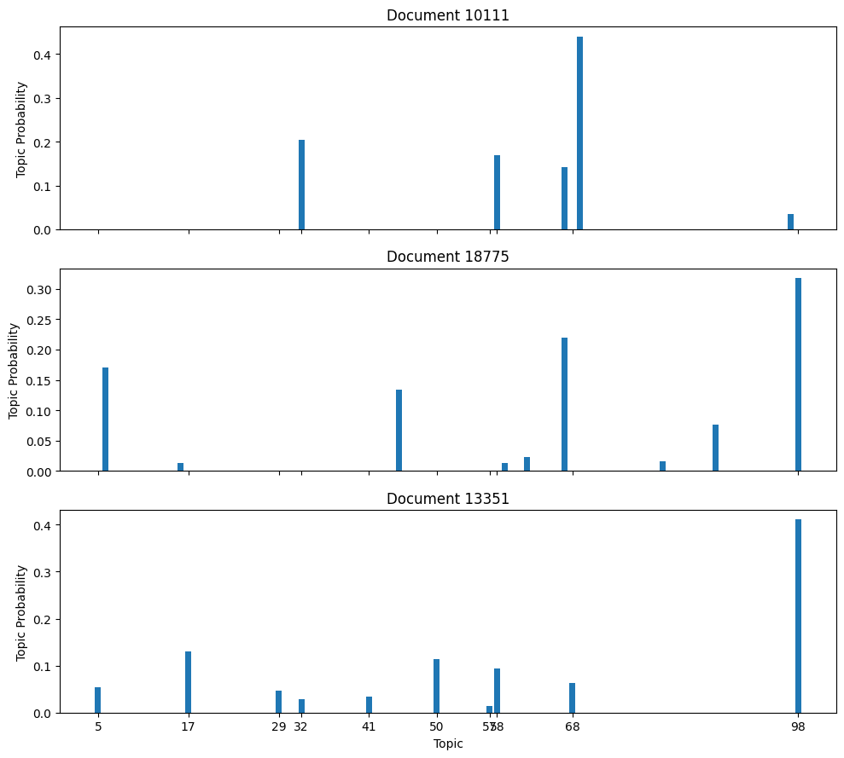
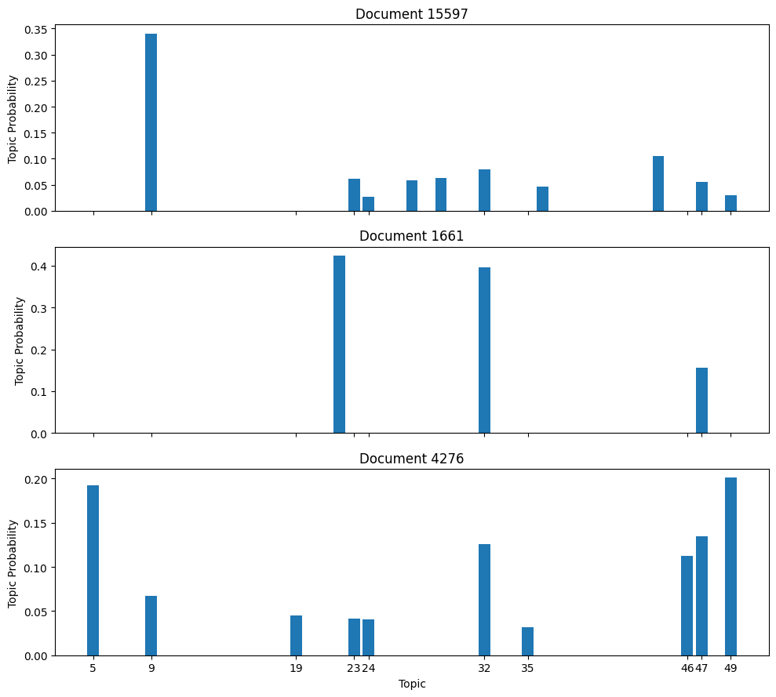
Per document topic proportions
Number of topics = 200
Number of topics = 100
Number of topics = 50

Slide 6
Per topic word distribution
Words from 20 sample topics
(27, '0.022*"room" + 0.014*"beijing" + 0.014*"majestic" + 0.012*"great" + 0.008*"staff" + 0.008*"stayed" + 0.007*"view" + 0.007*"bed" + 0.007*"stay" + 0.007*"night”’)
(41, '0.017*"great" + 0.014*"location" + 0.012*"stay" + 0.010*"gallery" + 0.010*"breakfast" + 0.009*"walk" + 0.009*"academy" + 0.008*"staff" + 0.008*"nice" + 0.008*"room”’)
(37, '0.026*"room" + 0.011*"time" + 0.010*"good" + 0.008*"pool" + 0.008*"staff" + 0.007*"great" + 0.006*"day" + 0.006*"2" + 0.005*"restaurant" + 0.005*"stay”’)
(45, '0.137*"barcelona" + 0.097*"euro" + 0.026*"fab" + 0.011*"day" + 0.009*"city" + 0.009*"great" + 0.008*"night" + 0.008*"stay" + 0.007*"room" + 0.007*"la”’)
(3, '0.036*"punta" + 0.032*"cana" + 0.021*"riu" + 0.021*"resort" + 0.018*"horse" + 0.013*"people" + 0.012*"food" + 0.011*"beach" + 0.009*"awsome" + 0.008*"6star”’)
(35, '0.015*"resort" + 0.014*"villa" + 0.011*"beach" + 0.010*"great" + 0.010*"time" + 0.010*"cana" + 0.010*"punta" + 0.010*"pool" + 0.009*"food" + 0.009*"room”’)
(24, '0.039*"great" + 0.021*"location" + 0.018*"room" + 0.017*"stay" + 0.015*"good" + 0.014*"staff" + 0.013*"nice" + 0.012*"clean" + 0.010*"place" + 0.010*"walk"')

Slide 7
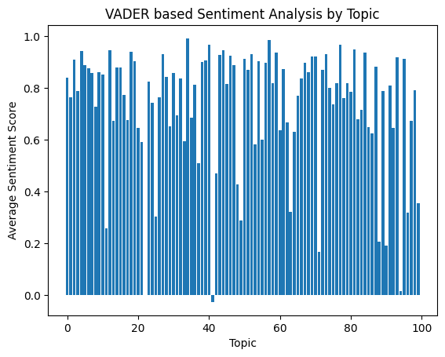
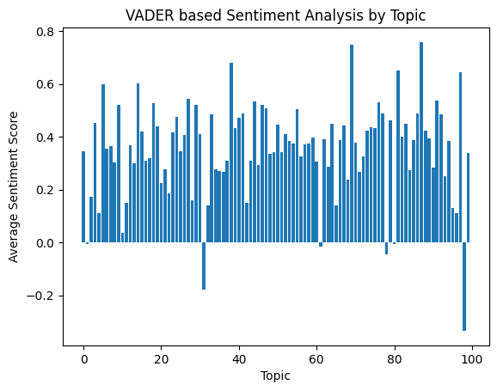
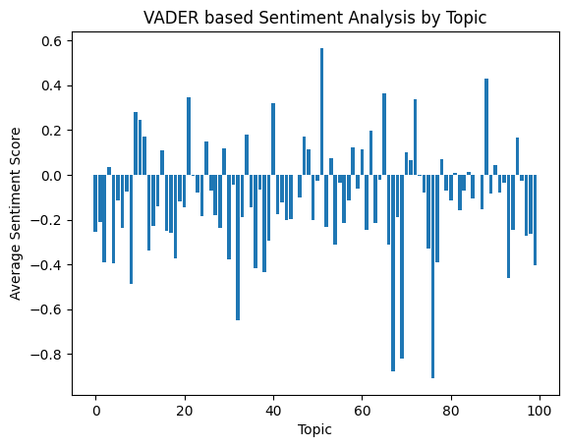
Sentiment Score (VADER method)
Lower ratings show negative sentiment
Ratings 1 to 5
Ratings 1 to 3
Rating 1

Slide 8
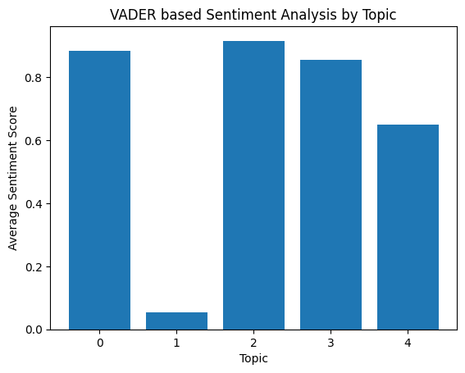
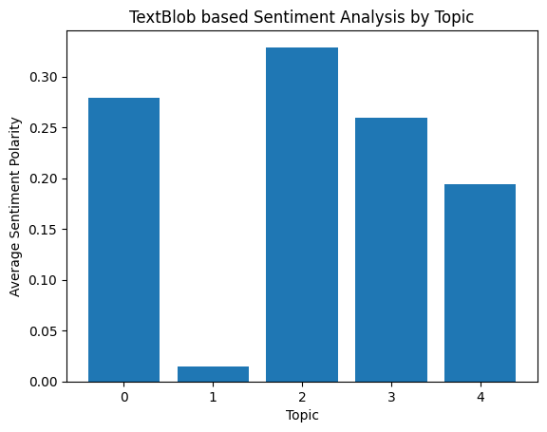
Sentiment Comparison (VADER and TextBlob)
Similar topic sentiment using 2 methods
Number of topics = 5

Slide 9
LDA (GENSIM)
Model Performance
Number of processed documents = 20,491
Total number of words in all reviews is 2,136,192
Total number of words in all reviews after processing is 1,992,542
Total number of unique words in all reviews after processing is 77,149
Number of Topics | Perplexity Score | Coherence Score
5 | -8.036570807887816 | 0.3449936728248204
50 | -10.689358425894168 | 0.33776505076046653
100 | -12.306198254812768 | 0.3524896845681038
200 | -16.311778551890004 | 0.3399224743615561

Slide 10
Dataset Details and Data Clean Up Methods
Sajal Debnath
Dataset: New York Airbnb Open Data – Kaggle
Work on subset of the data through column selection
Removal of missing values
Pre-processing:
Replacing URLs: Links starting with "http" or "https" or "www" are replaced by "URL".
Replacing Emojis: Replace emojis by using a pre-defined dictionary containing emojis along with their meaning. (eg: ":)" to "EMOJIsmile")
Removing Non-Alphabets: Replacing characters except Digits and Alphabets with a space.
Removing Consecutive letters: 3 or more consecutive letters are replaced by 2 letters. (eg: "Heyyyy" to "Heyy")
Removing Short Words: Words with length less than 2 are removed.
Removing Stopwords: Stopwords are the English words which does not add much meaning to a sentence. They can safely be ignored without sacrificing the meaning of the sentence. (eg: "the", "he", "have")
Lemmatizing: Lemmatization is the process of converting a word to its base form. (e.g: “Great” to “Good”)
Lower Casing: Each text is converted to lowercase.
Tokenization of words
*** Please check Sajal Debnath’s GitHub Repository for all the details.

Slide 11
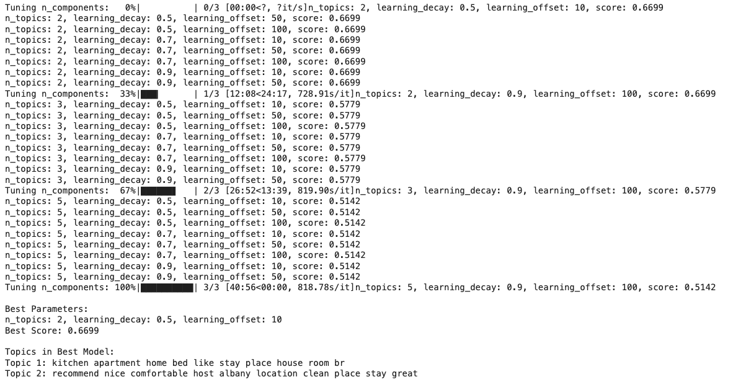

Results – Sajal Debnath – Scikit-Learn Library - Coherence Score
I am using Scikit-learn library to implement LDA mode
I am using Coherence score using cosine similarity to calculate the effectiveness of the model
The coherence score before hyper tuning is 0.2495
After hyper tuning the best score is 0.6699
N_topics: 3
Learning_decay: 0.7
Learning_offset: 10

Slide 12
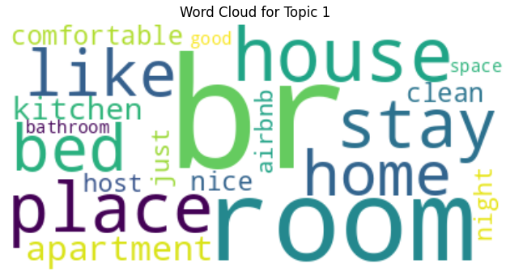
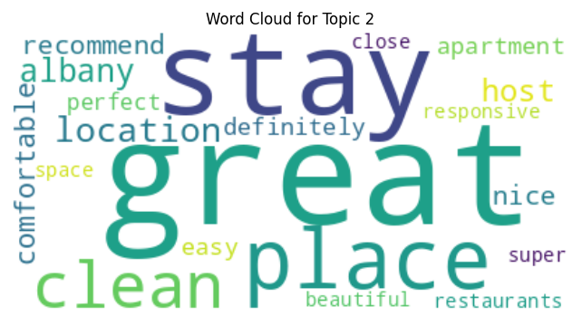
Results - 1
Wordcloud

Slide 13
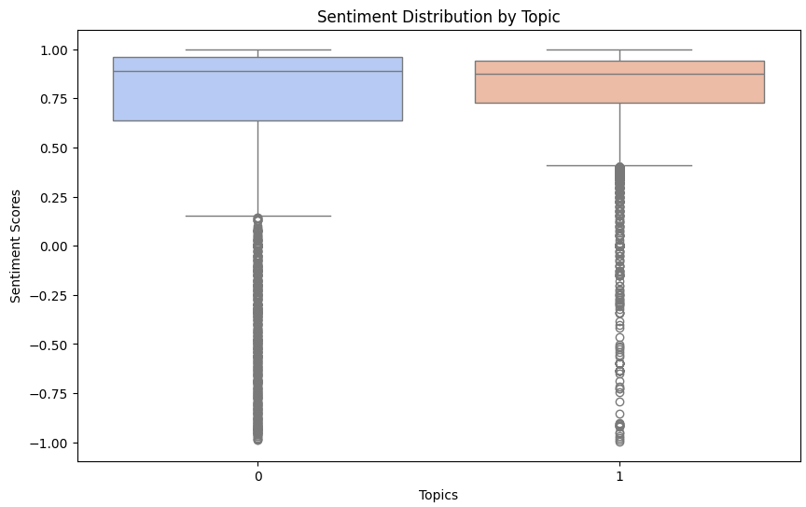
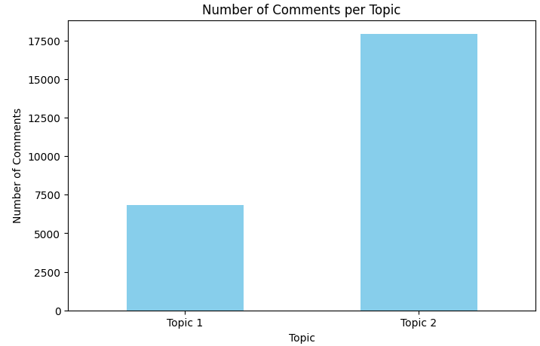
Results – 2
Sentiment Distribution, No. of Comments/topic

Slide 14
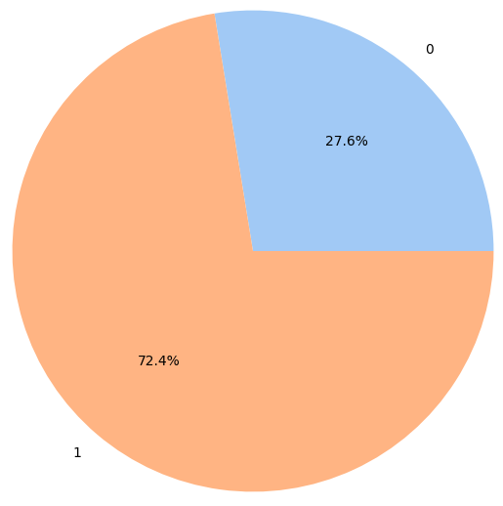
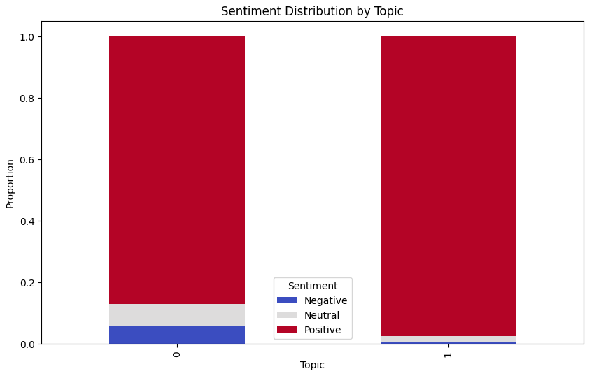
Results - 3
Comments/topic , Sentiment distribution/topic
Proportion of Comments per Topic

Slide 15
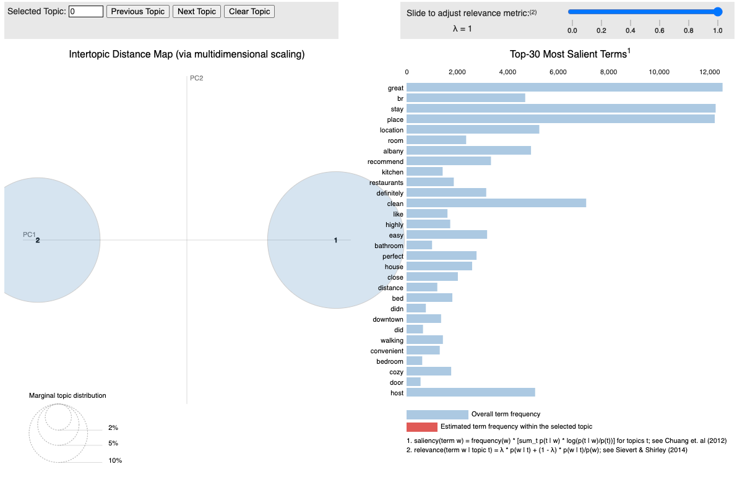
Results – 4
Interactive Visualization with pyLDAvis

Slide 16
Contributions
Sajal Debnath
Krishanu Chattopadhyay
Data cleanup and acquisition - 50 / 100
ML Model Selection/ Training - 50/ 100
Hyper parameter tuning - 50 /100
Metrics - 50/ 100
Presentation - 50 / 100
Documentation - 50 / 100
Data cleanup and acquisition - 50 / 100
ML Model Selection/ Training - 50 / 100
Hyper parameter tuning - 50 /100
Metrics - 50 / 100
Presentation - 50/ 100
Documentation - 50 / 100

Slide 17
Conclusion
In conclusion we can say that while LDA is a very powerful algorithm, there are other models we need to explore. For example, pLSA model and others. Also, we need to continue working on the datasets and the model to make it more useful.
We need both time and effort to fine tune the models and adopt it as per the datasets.
For the Airbnb dataset, the sentiment is overwhelmingly positive, this is due to the nature of the reviews. We need to test the model with other datasets with actual rating and compare them with the generated ratings to find out the accuracy of the model.
For generating the LDA model with TripAdvisor dataset, the model was trained in 1 pass. The library gave a warning that the model was not converging, and more iteration needs to be performed. However, with the hardware provided in Google Colab runtime, this was not possible.

